Slide 1
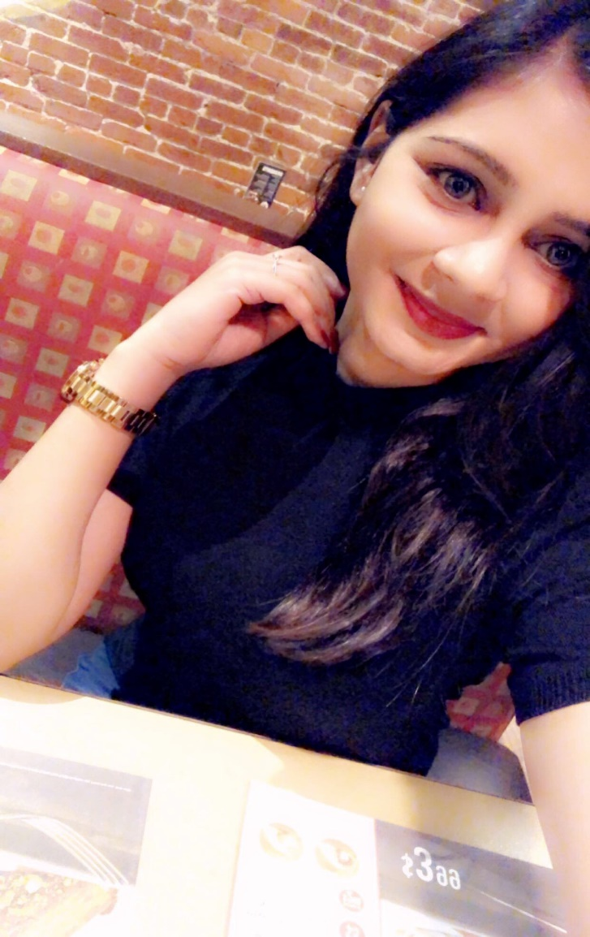
Introduction
Bhoomi Panchal

Slide 2
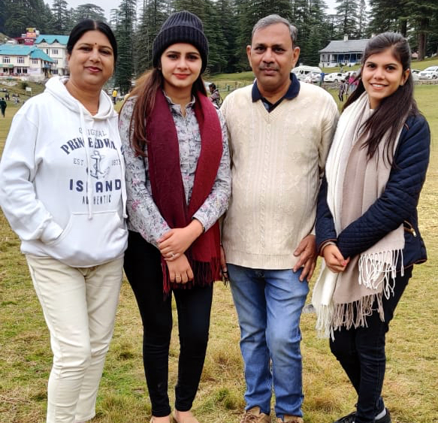
I am 24 years old. I am from Mumbai, India. Currently, I am living in Brampton, Canada.
I did Fundamental Arts in Holland College, Prince Edward Island and now I am taking Early Childhood Education.
I am older in my family; I have one younger sister and she lives in India.
My father has a food business in India and my mother is an architect- engineer.

Slide 3
▪ My grandparents are also living with us in India.
▪ I love both so much, my grandpa is my hero.
▪ Cleaning is my obsession. I love to clean my house, my room and everything.
▪ I love old, Indian classical music and, I play Sitar instrument.
▪ I love to travel and explore me. Wants to learn different languages and cultures.
▪ I love kids and in future, I would like to open my own daycare for disable kids and help them, teach them, that’s my goal.

Slide 4
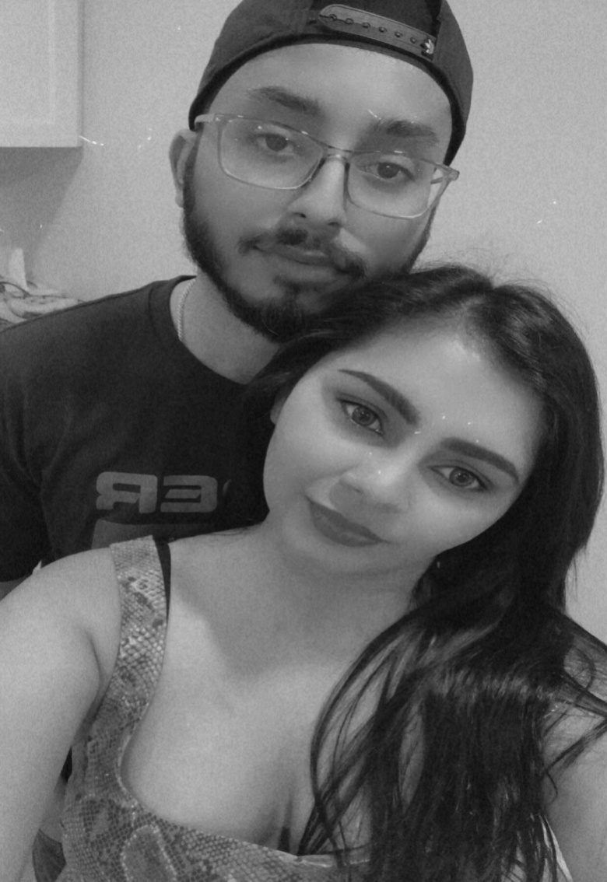
▪ This is my Boyfriend; his name is Sahib.
▪ I met him 3 years ago, he is a very gentle and loving, caring partner.
▪ Last year I faced some high depression and mental breakdown, he was always there for me and understand my condition very well.
▪ I feel so confident now and trying to stay positive and strong.

Slide 5
I consider myself a very caring, fun-loving and strong woman. I get easily upset when someone said something to me, because I can’t get back to anyone. I had so many bad experiences in my life, because I trusted people and they use me but I handle me.
As I mentioned earlier, I was so pampered in India and lived with full facilities but when I came to Canada my whole life changed. I become a strong and independent girl and faced lots of realities that I never faced in India.
I was very shy in India, but when I came here, I realize that life is very different, you have to stand for yourself no matter what. You have to work hard. As being an international student, I can only work for 20 hours a week and do study. So it’s become quite difficult for me to manage my financial needs.

Slide 6
In Canada, I worked in so many different places, like fast-food restaurants, bar, retail stores like gap, h&m, call centre, gas station, and daycares and babysitting as well.
Currently, I am babysitting a 3-year-old. He is a very sweet and loving kid, I love taking care of him. I am not only babysitting but also playing a role of an educator to him.
That helps me to build my experience in this child care provider field. When I teach him or give him proper guidance I feel so satisfied.

